Slide 1
How better tech could protect us from distraction
Talk by – Tristan Harris
(Design Thinker)

Slide 2
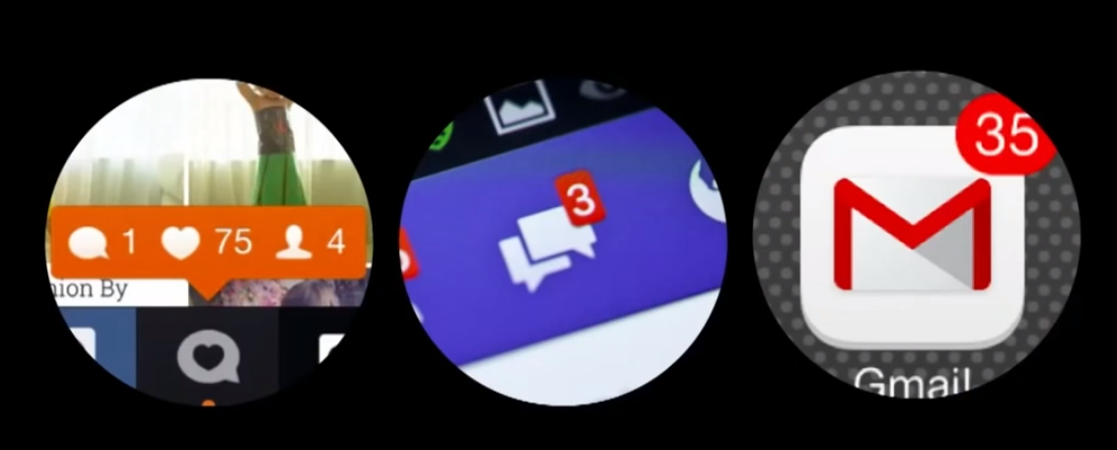
How do we spend our time?

Slide 3
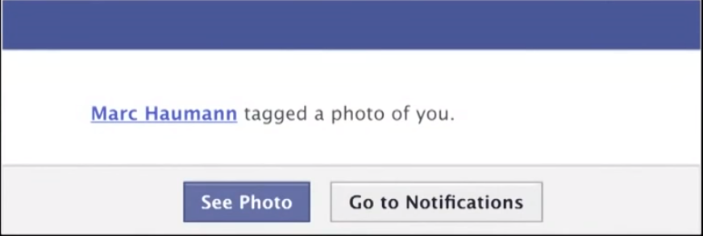
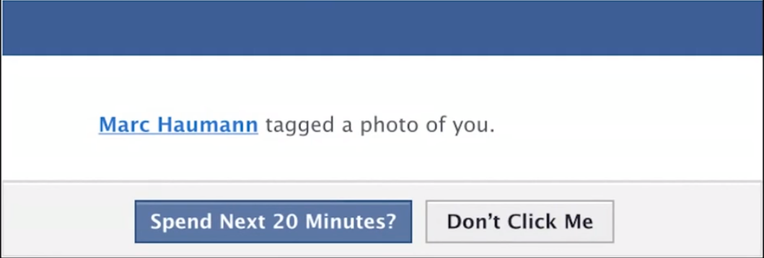
Example 1:

Slide 4
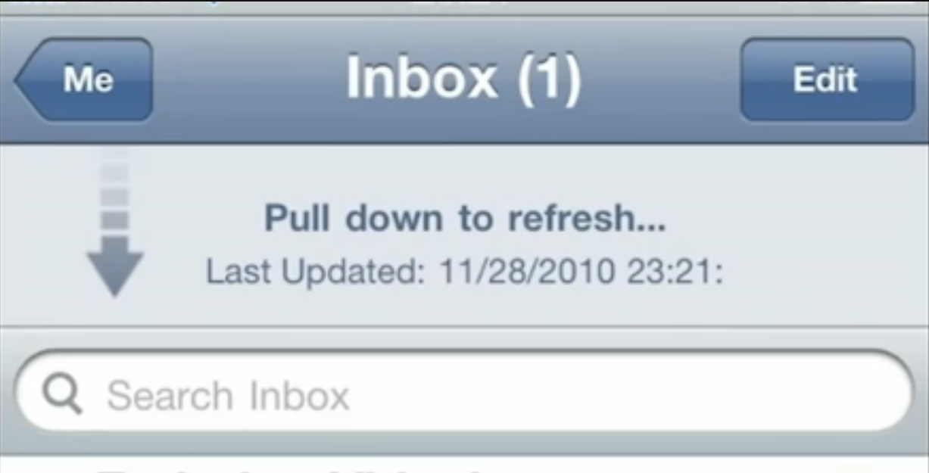
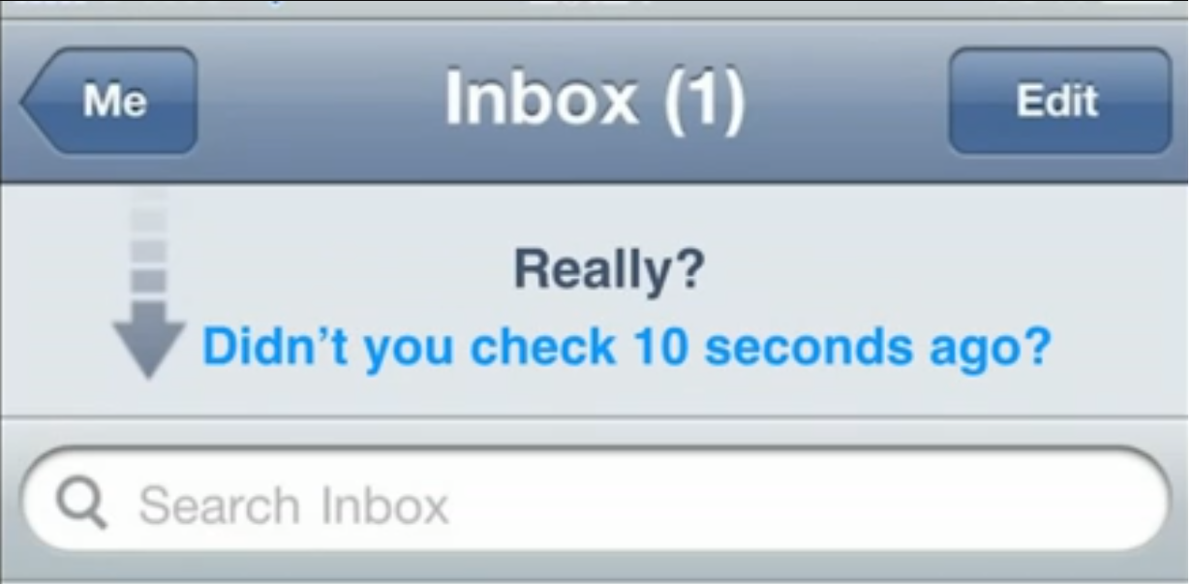
Example 2:

Slide 5
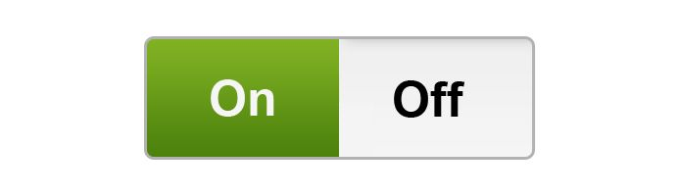
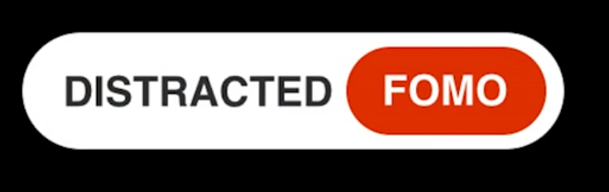
All or nothing relationship with Technology

Slide 6
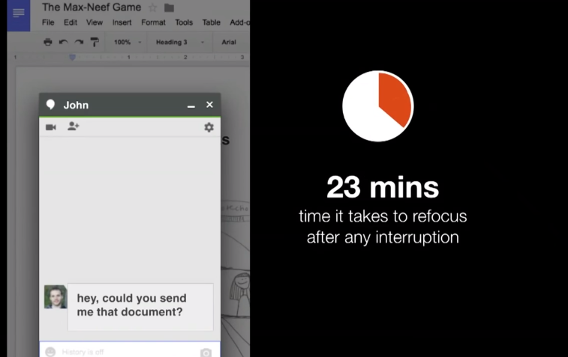
Chat Application

Slide 7
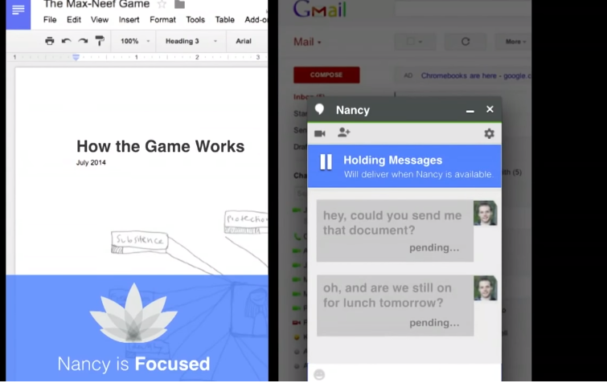
Chat Application with new design goal

Slide 8
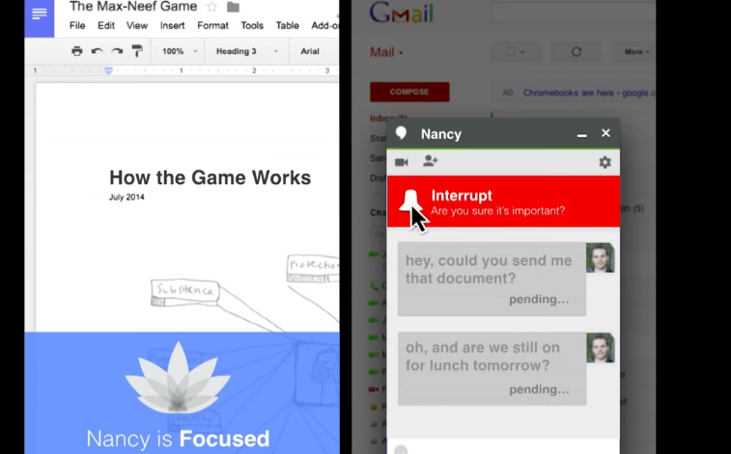
Chat Application with new design goal

Slide 9
Previous design goal:
Send message quickly and easily.
Human design goal:
High-quality communication and relationship.

Slide 10
We can create this world today!
Company leaders – Prioritize new matric
Designer – Redefine the design
Users – Demand technology that work this way

Slide 11
Time
spent
Time
well
spent

Slide 12
THANK YOU!!

